Slide 1

Aie Programming Year 1 Game AI Craig Lovell
Prison Escape

Slide 2
Prison Escape - About / Pitch
You’re a prisoner trying to escape without being caught by the guards. You've found 2 switches that you use to escape but you must avoid being seen as you try to escape.
The main aim of the game will be for the player to escape the prison without being caught by the guards the way he escapes is by flipping the switch in the guard room to open the main door if caught by the guards it will add time to the clock.

Slide 3



Prison Escape - Entities
Guards
Guards will follow the given path unless the player is seen
Player
Needs to interact with the switch in the guard room to open door to escape.
Be in the right room at the right time to make guards happy.
Player
Guard

Slide 4
Prison Escape - Player
Tasks
Has 2 Tasks to flip the 2 switches to open the doors to escape
Has 1 core task and that is to escape
Behaviours
Controlled by W A S D to move around the map
Aim
To escape the prison without being caught by the guards

Slide 5
Prison Escape - Guard
Tasks
Follow the given path and if player is seen seek the last seen location and on arrival if player is not there go back to followpath
Behaviours
Follow Path Around Prison on a given path
Seek Player when seen
Aim
Stop Player from escaping

Slide 6
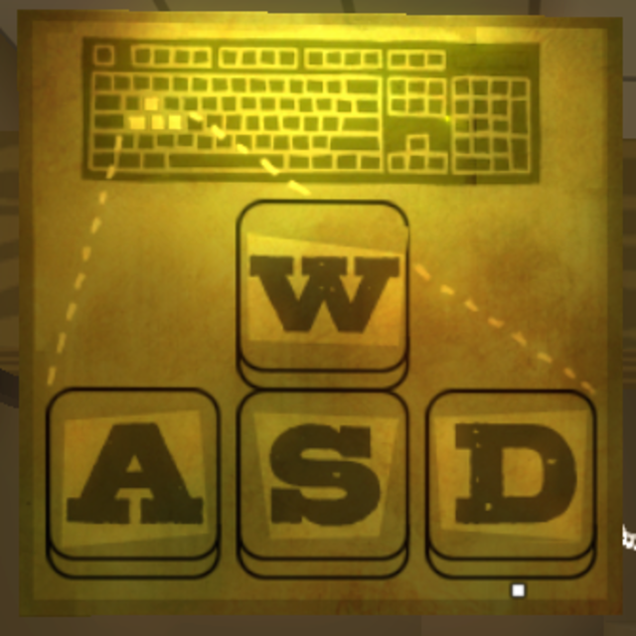
Prison Escape - Movement
Player (W, A, S, D)
Guard (Follow path, Seek, Path)

Slide 7

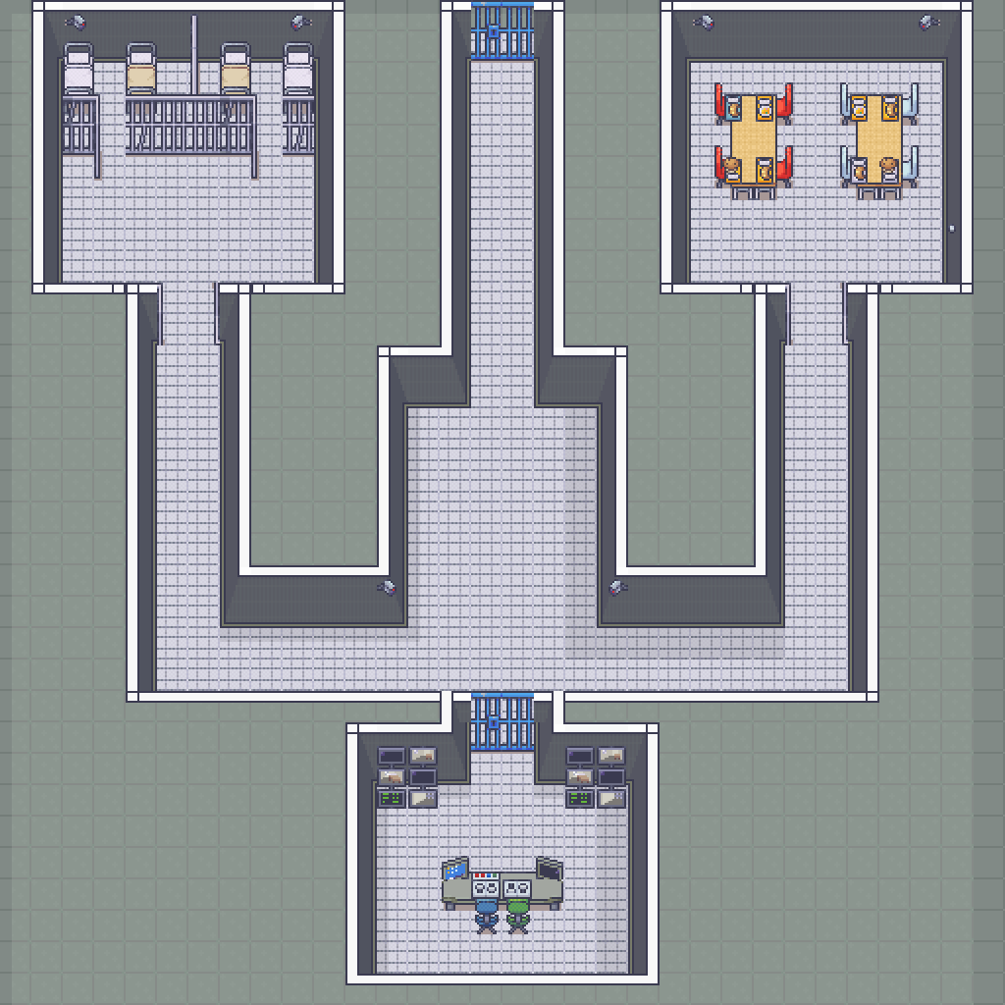
Prison Escape
Red = Player Spawn
Green = Switch 1
Purple = Doors that need to be opened
Black = Walls
Aqua = Guard Spawns
Blue = Switch 2
Orange = Escape Door

Slide 8
Prison Escape - Game States
Menu
Game Screen
Pause Screen
Game Over / Time Taken
Menu
Game
Pause
Game Over

Slide 9
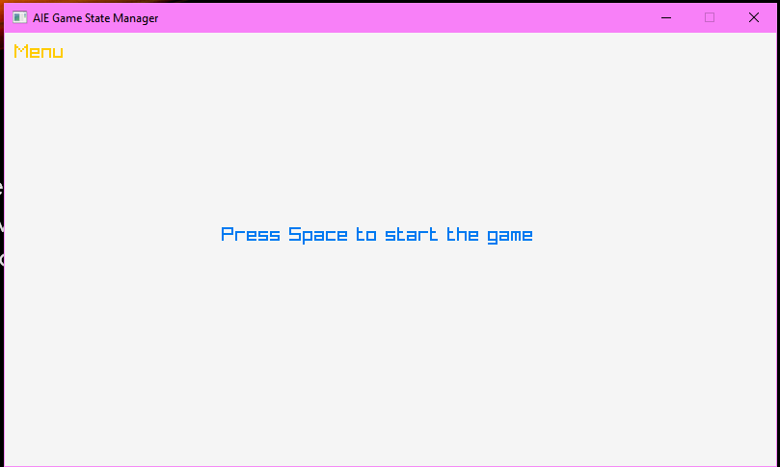
Prison Escape - Menu
Menu Screen
Menu Screen will be the first screen of the game states this will be where you can pick to play the game or see the times scores of previous games

Slide 10
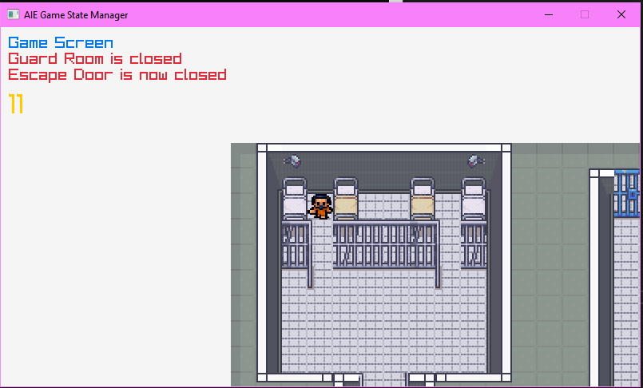
Prison Escape - Game screen
Game Screen
From the game screen you can go to pause and from pause back to the menu - Left Shift pauses game - Caps Lock shows solid tiles / walls - Tab shows the tile map coloured tiles used to code specific things - Enter Shows all the nodes on the map - Z shows the nodes for the guards path

Slide 11
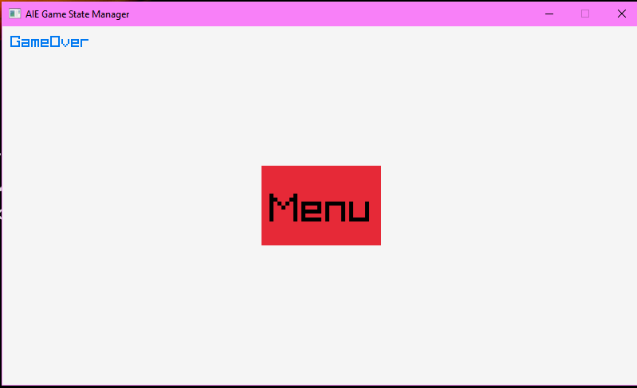
Prison Escape - Game Over
Game Over Screen
Will Show time taken to escape
A way back to menu to restart and play again

Slide 12
Prison Escape - Behaviours
Keyboard
W,A,S,D
Move the player around the map.
Follow path
Follows the given path generated using dystras
Seek
When is set into seek mode guards will seek player out to put him back into his sell and or into lockdown

Slide 13
Prison Escape - Decision tree
Is player seen
I am using a blackboard that saves the last seen location of the player which the guards seek towards if the guard sees the play this will always update as long as the player is in the guards radius if the player is not in the radius the guards follow a given path around the prison.
Yes
no
Seek Player
FollowPath

Slide 14
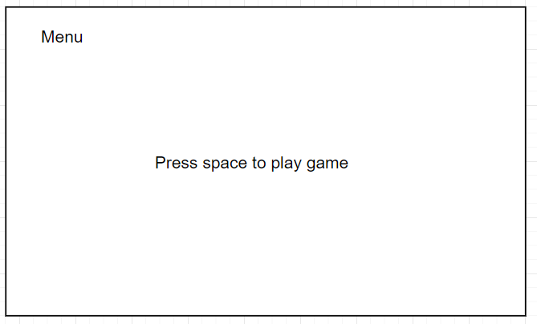
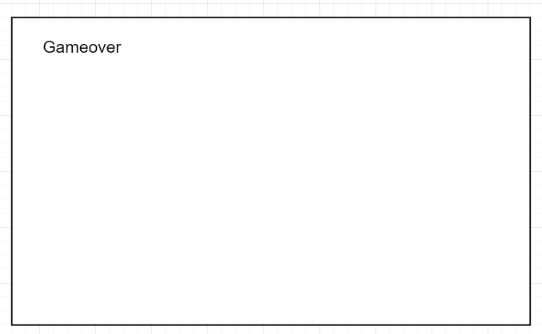
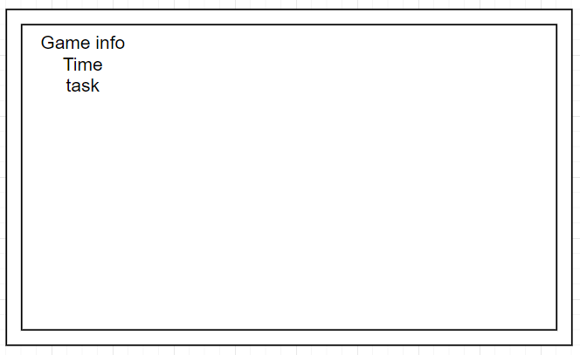
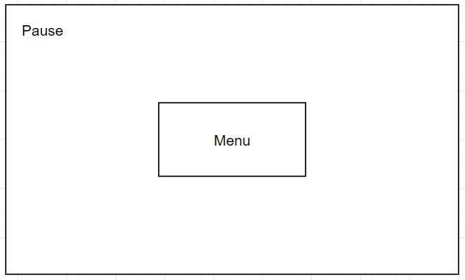
Prison Escape - Wireframes

Slide 15
Prison Escape
Collisions
 | //TODO add actions
- | Nothing
1 | Plays Sound (Didn’t get around to it)
2 | Flee
3 | Follow Path
4 | Seek
5 | Resolve collision
PLAYER
1-5-4
1
1-3
Guard

Slide 16
Prison Escape - Stretch Goals
Cameras
Bullets
Time base tasks

Slide 17
Prison Escape - Cameras
Stretch Goal
Tasks // TODO
Behaviours // TODO
Aim
Routine

